Slide 1

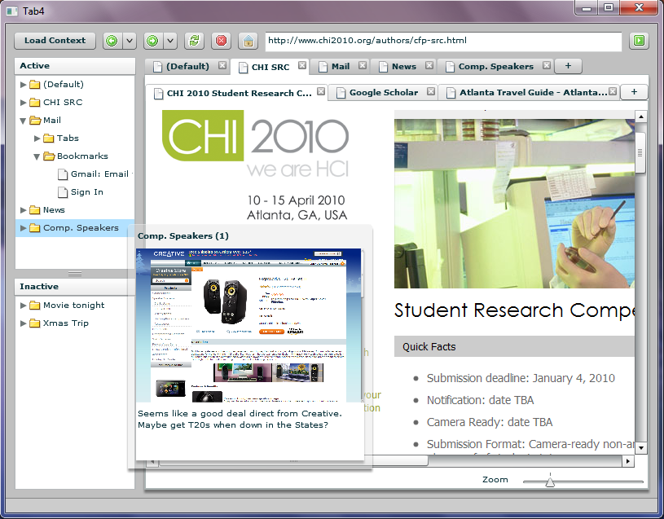
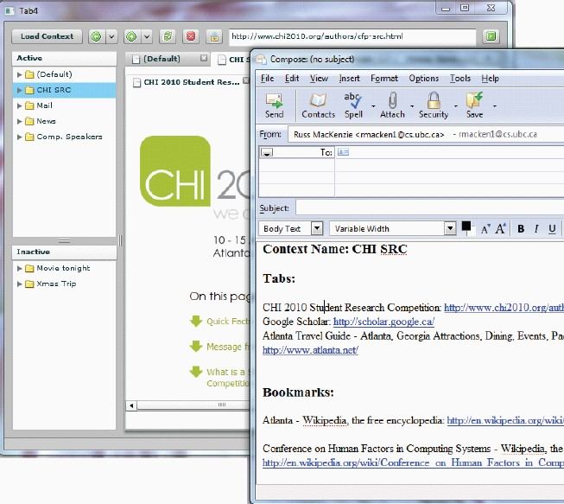
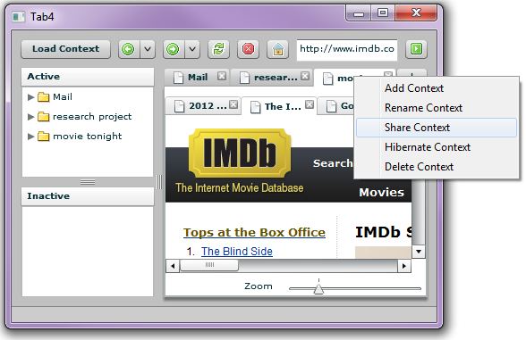
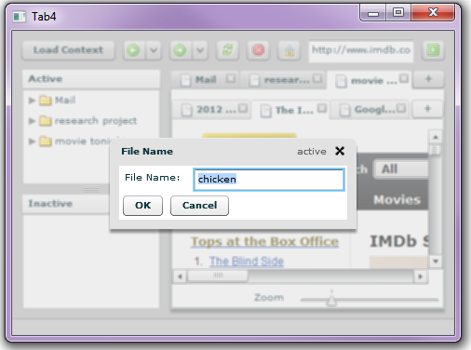
Tab4
A Task-Focused Approach to Support Sharing And Interruption Recovery in Web Browsers
Mohan Raj Rajamanickam, Billy Lam, Russell MacKenzie, Tao Su.
The University of British Columbia. tabfour@googlegroup.com
The “Active” task sidebar shows currently active tasks. Since these bookmarks are specific to the “CHI SRC” task, they don’t interfere the users while using other tasks.
Additional task bar to group multiple tabs
Task-Focused Browsing
Tab4 is a prototype browser interface designed to better support users whom regularly use browsers for myriad tasks. Specifically, the Tab4 browser interface enables the following features related to tasks and their artifacts (i.e. tabs, bookmarks and annotations).
Webpages can be grouped into tasks, providing a unified target for resumption.
Tasks and pages can be annotated, supporting resumption after long intervals.
Tasks can be shared through a novel web-service easily.
Hovering over a task in the sidebar causes a transient popup to appear. The popup shows a thumbnail view of a tab within the task, and supports annotations in the text box at the bottom of the popup.
The “Inactive” sidebar lists two tasks which are currently suspended; double-clicking activates these tasks.
Design Requirements
Through a series of interviews to explore users’ browsing habits, we generated a set of five design requirements that aid the development of Tab4:
Support the grouping of webpages into tasks
Facilitate task switching and resumption
Include navigation artifacts (i.e. bookmarks) as part of a task
Allow annotation of webpages and tasks
Ease sharing of pages and tasks between users
A task can be shared as regular hypertext by dragging and dropping it into a document or an email. The hypertext contains information of all the artifacts, including tabs, bookmarks and annotations, as shown in the email client in the image.
Evaluation
Our experiment evaluates the suitability of the Tab4 browser to support task switching in a high-pressure, interruption-ridden settings. Eight participants were asked to use our prototype for two 15-minute sessions to perform specific tasks while getting interrupted occasionally by the experimenter.
All subjects indicated task-based browsing is useful, making it easier to complete the assigned tasks, and that they would use task-based browsing if available in their primary browser.
share
web service
Future Directions
We identified the following areas which are worthy of further investigations:
including browsing history as part of the task artifacts
long-term, real-world usage of a functionally complete system, with logging and critical incident interviews
incorporate our interface as a plug-in to existing browsers, such as Mozilla Firefox or Google Chrome
load

